Slide 1

L 33
Disk scheduling algorithms: FCFS, SSTF, SCAN with examples
Presented by:
Veena K M
OS Teacher for IV IT A
9845714070
veena.gv@manipal.edu

Slide 2
Disk Scheduling
The access time has two major components:
seek time: is the time for the disk arm to move the heads to the cylinder containing the desired track.
Rotational latency: is the additional time for the disk to rotate the desired sector to the disk head.
The disk bandwidth is the total number of bytes transferred, divided by the total time between the first request for service and the completion of the last transfer.
We can improve both the access time (must be reduced) and the bandwidth (must be increased) by managing the order in which disk I/O requests are serviced.

Slide 3
Disk Scheduling algorithms
FCFS (First Come First Serve):
simplest disk scheduling algorithm.
entertains requests in the order they arrive in the disk queue.
The algorithm looks very fair and there is no starvation (all requests are serviced sequentially)
but generally, it does not provide the fastest service.
2. SSTF (Shortest Seek Time First):
Selects the request with the minimum seek time from the current head position
SSTF scheduling is a form of SJF CPU scheduling
may cause starvation of some requests
3. SCAN
Also known as elevator algorithm
The disk arm starts at one end of the disk, and moves toward the other end, servicing requests until it gets to the other end of the disk, where the head movement is reversed and servicing continues.
Several other algorithms exist to schedule the servicing of disk I/O requests

Slide 4
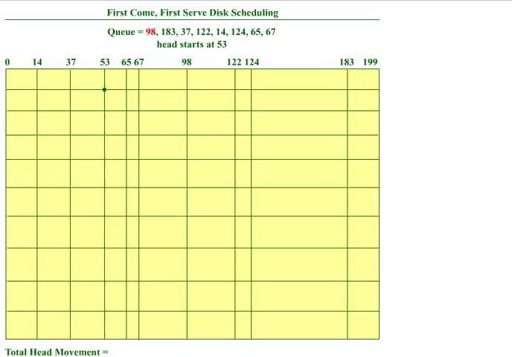
Animation of FCFS

Slide 5
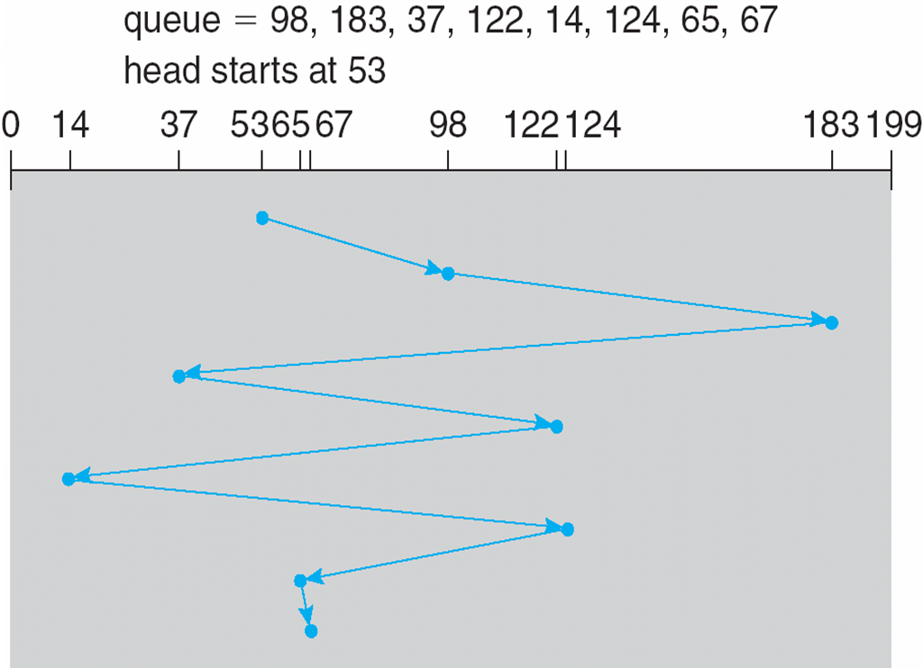
1. FCFS
Disk Scheduling algorithms
Illustration shows total head movement of 640 cylinders
Total number of head movements=
|98-53|+|183-98|+|37-183|+|122-37|
+|14-122|+|124-14|+|65-124|+|67-65|
=45+85+146+85+108+110+59+2
=640
Which could also be computed by using the extreme ends in the diagram as follows:
|53-183|+|183-37|+|37-122|+
+|122-14|+|14-124|+|124-65|+|65-67|
=130+146+85+108+110+59+2
=640

Slide 6
1.FCFS
Disk Scheduling algorithms
The wild swing from 122 to 14 and then back to 124 illustrates the problem with this schedule.
If the requests for cylinders 37 and 14 could be serviced together, the total head movement could be decreased substantially, and performance could be thereby improved.

Slide 7
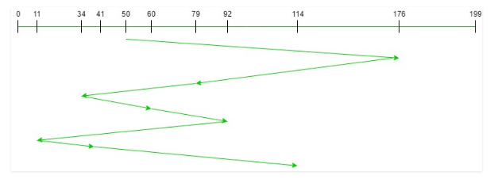
1. FCFS
Disk Scheduling algorithms
Input:
Request sequence = {176, 79, 34, 60, 92, 11, 41, 114}
Current head position = 50
Output:
Total number of head movements
= (176-50)+(176-79)+(79-34)+(60-34)+(92-60)+(92-11)+(41-11)+(114-41)
= 510 cylinders

Slide 8
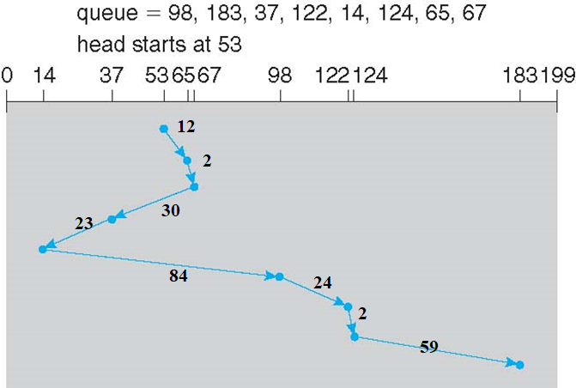
2. SSTF
Disk Scheduling algorithms
Illustration shows total head movement of 236 cylinders
Total number of head movements can be easily computed by finding the difference between extreme ends:
=(67-53)+(67-14)+(183-14)
=14+53+169
=236 cylinders
=(65-53)+(67-65)+(67-37)+(37-14)
+(98-14)+(122-98)+(124-122)+(183-124)
=12+2+30+23+84+24+2+59
=236 cylinders

Slide 9
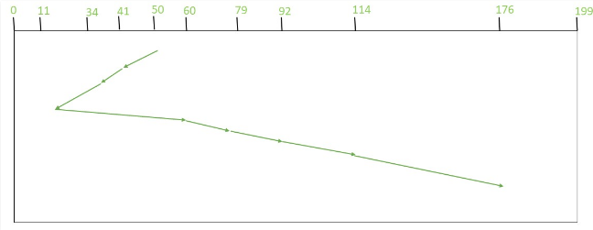
2. SSTF
Disk Scheduling algorithms
Request sequence = {176, 79, 34, 60, 92, 11, 41, 114}
Initial head position = 50
The following chart shows the sequence in which requested tracks are serviced using SSTF.
Total number of head movements can be easily computed by finding the difference between extreme ends:
(50-11)+(176-11)
=204
Total number of head movements
=(50-41)+(41-34)+(34-11)+(60-11)+(79-60)+(92-79)+(114-92)+(176-114)
= 204 cylinders

Slide 10
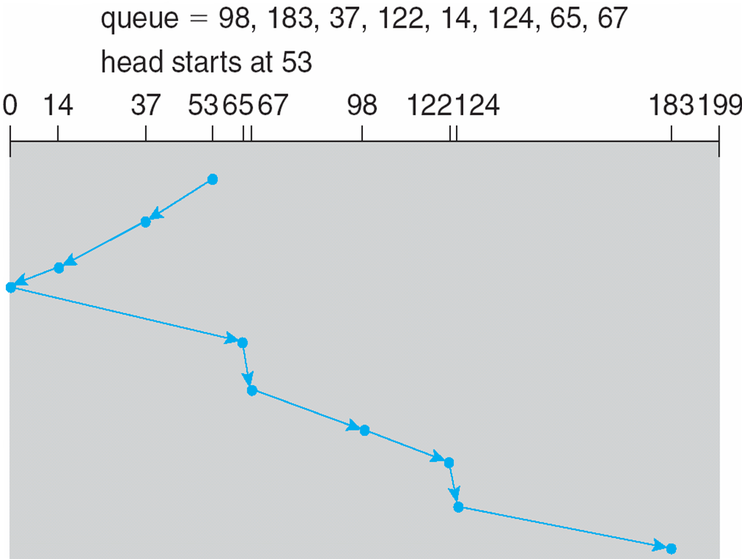
3. SCAN
Disk Scheduling algorithms
Illustration shows total head movement of 236 cylinders

Slide 11
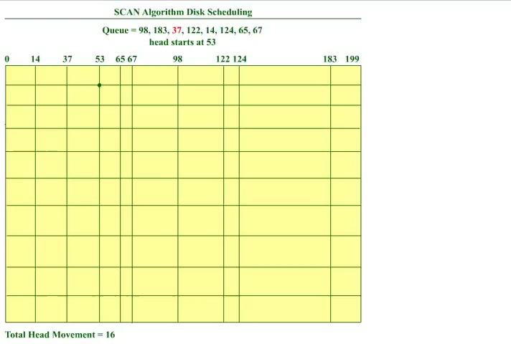
Animation of SCAN

Slide 12
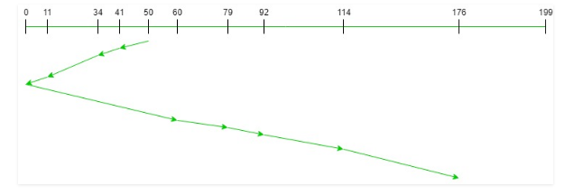
3. SCAN
Disk Scheduling algorithms
Input:
Request sequence = {176, 79, 34, 60, 92, 11, 41, 114}
Initial head position = 50
Direction = left (towards left)
Total number of head movements
= (50-41)+(41-34)+(34-11) +(11-0)+(60-0)
+(79-60) +(92-79)+(114-92)+(176-114)
= 226 cylinders
Total number of head movements can be easily computed by finding the difference between extreme ends:
(50-0)+(176-0)
=226

Slide 13
Exercise
Suppose that a disk drive has 5,000 cylinders, numbered 0 to 4999. The drive is currently serving a request at cylinder 143, and the previous request was at cylinder 125. The queue of pending requests, in FIFO order, is:
86, 1470, 913, 1774, 948, 1509, 1022, 1750, 130
Starting from the current head position, what is the total distance (in cylinders) that the disk arm moves to satisfy all the pending requests for each of the following disk-scheduling algorithms?
a. FCFS
b. SSTF
c. SCAN

Slide 14
Thank you

